Slide 1
ARP Spoofing (Part I)

Slide 2
Introduction
A computer connected to an IP/Ethernet has two addresses
  MAC address / Hardware address / Physical address
    Globally unique address stored in the network card.
    Ethernet header contains the MAC address of the source and the destination computer.
  IP address
    Each computer on a network must have a unique IP address to communicate.
    Virtual and assigned by software.

Slide 3
IP communicates by constructing packets.
Packets are delivered by Ethernet.
  Adds an Ethernet header for delivery
  Splits the packets into frames
  Sends them down the cable to the switch.
  The switch then decides which port to send the frame to. By comparing the destination address of the frame to an internal table that maps port numbers to MAC addresses.

Slide 4
When an Ethernet frame is constructed from an IP packet, it has no idea what the MAC address of the destination machine is.
The only information available is the destination IP address.
There must be a way to the Ethernet protocol to find the MAC address of the destination machine, given a destination IP.
This is where ARP, Address Resolution Protocol, come in.

Slide 5
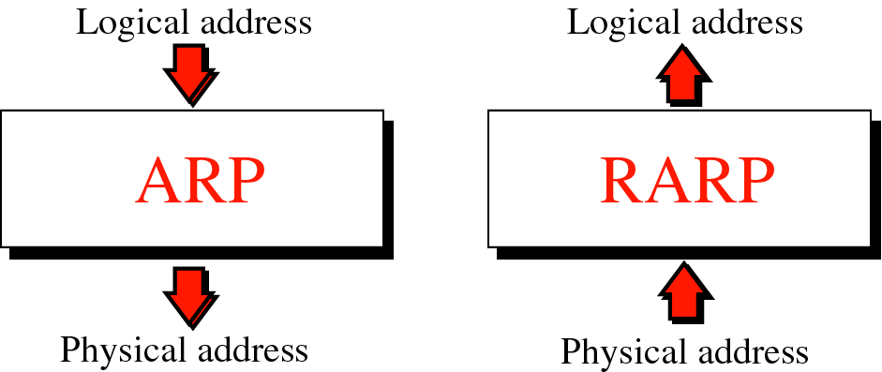
Figure 8-1
Address resolution and Reverse address resolution
Notes:
RARP is rarely used nowadays.

Slide 6
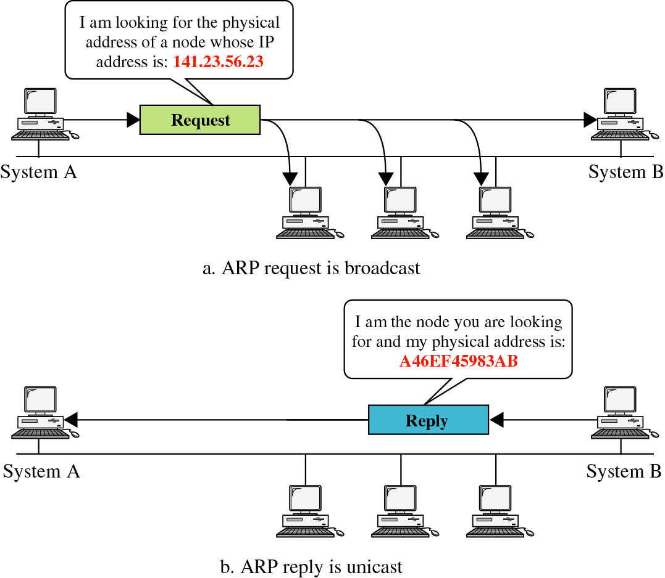
Figure 8-2
ARP
Notes:
Demo

Slide 7
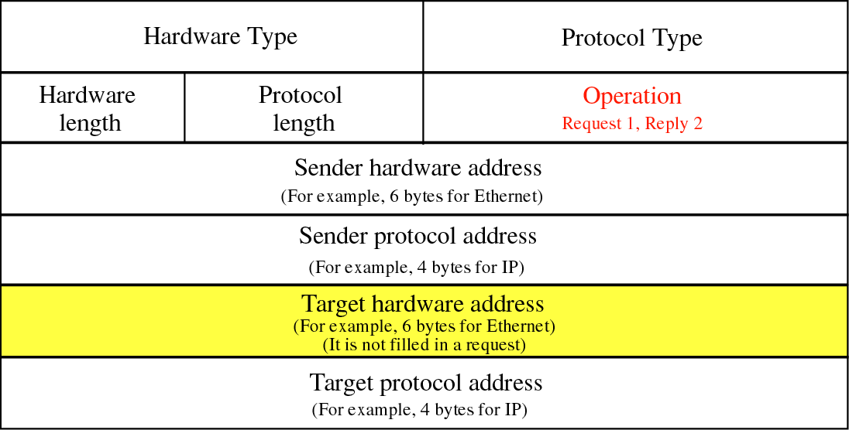
Figure 8-3
Notes:
Demo

Slide 8
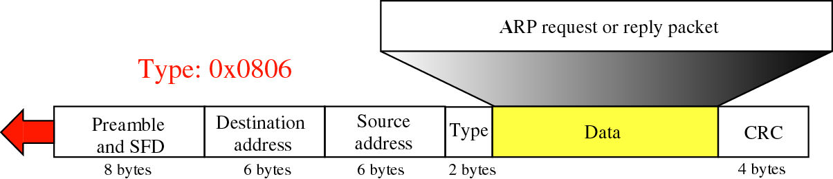
Figure 8-4
Encapsulation of ARP
Notes:
Ethernet frame
SFD: Start Frame Delimiter

Slide 9
How ARP functions:
  Get IP address of target.
  Create a request ARP message
    Fill sender physical address
    Fill sender IP address
    Fill target IP address
    Target physical address is filled with 0
  The message is passed to the data link layer where it is encapsulated in a frame.
    Source address: physical address of the sender.
    Destination address: broadcast address.

Slide 10
  Every host or router on the LAN receives the frame.
    All machines check the ARP data.
    All machines except the one targeted drop the packet.
  The target machine replies with an ARP message that contains its physical address.
    A unicast message.
  The sender receives the reply message and knows the physical address of the target machine.

Slide 11
A’s ARP request
ARP request packet
  Sender Hardware Address - A’s MAC address
  Sender Protocol Address – A’s IP address
  Target Hardware Address – Zeroes
  Target Protocol Address – B’s IP address
Ethernet layer
  Source Hardware Address – A’s MAC address
  Target Hardware Address – FF:FF:FF:FF:FF:FF

Slide 12
B’s ARP reply
ARP reply packet
  Sender Hardware Address - B’s MAC address
  Sender Protocol Address – B’s IP address
  Target Hardware Address – A’s MAC address
  Target Protocol Address – A’s IP address
Ethernet layer
  Source Hardware Address – B’s MAC address
  Target Hardware Address – A’s MAC address

Slide 13
  To avoid having to send an ARP request packet each time, a host can cache the IP and the corresponding host addresses in its ARP table (ARP cache).
  Each entry in the ARP table is usually “aged” so that the contents are erased if no activity occurs within a certain period.
  When a computer receives an ARP reply, it will update its ARP cache.
  ARP is a stateless protocol, most operating systems will update their cache if a reply is received, regardless of whether they have sent out an actual request.
Notes:
Demo for arp
"arp –d <ip_address>" to delete an entry

Slide 14
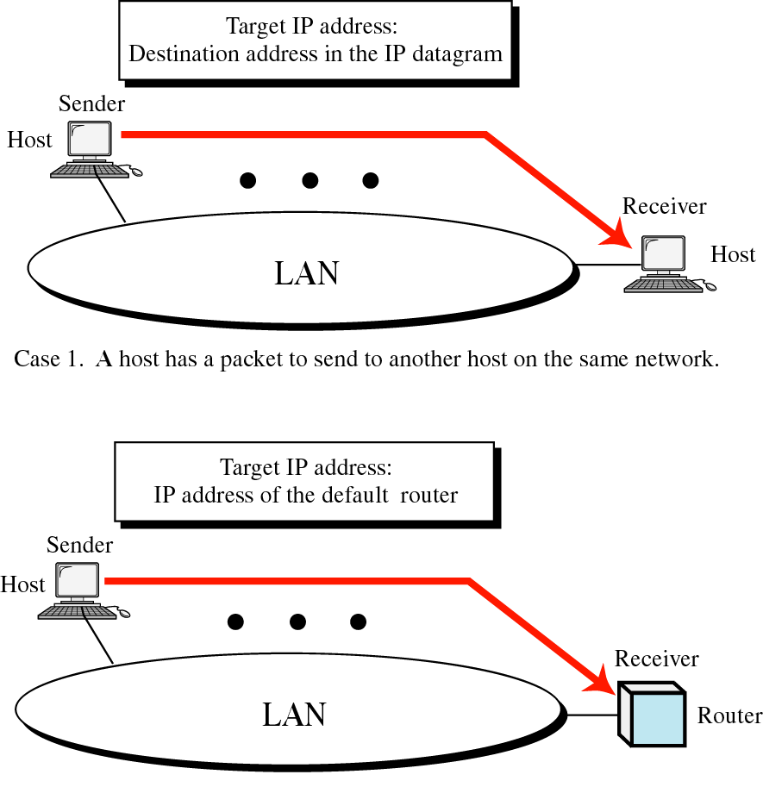
Figure 8-5, Part I
Case 2. A host wants to send a packet to another host on another network. It must first be delivered to a router.

Slide 15
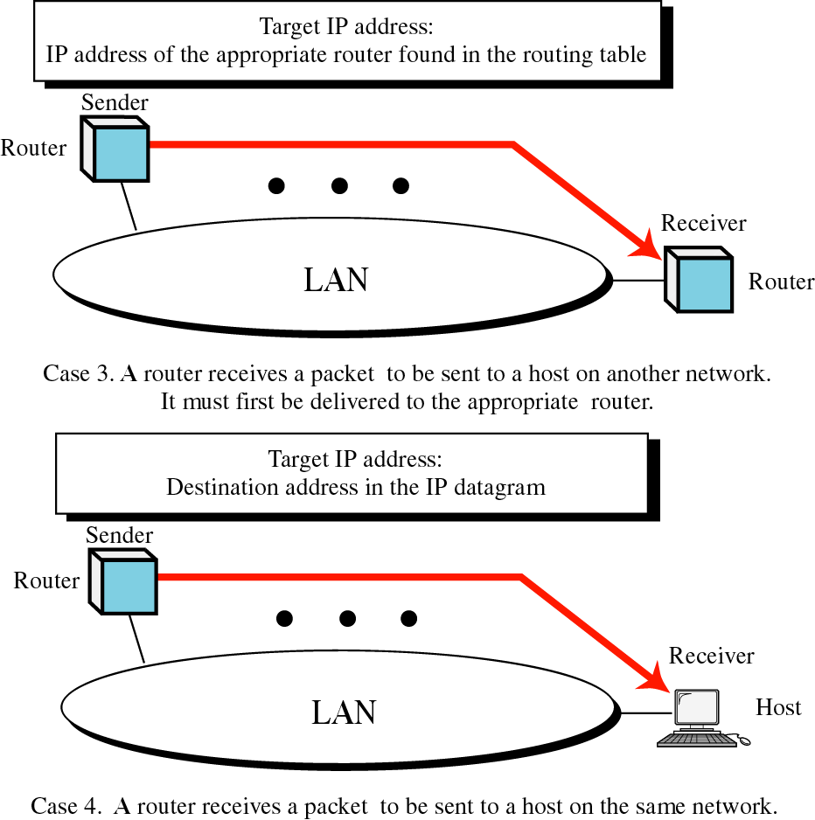
Figure 8-5, Part II

Slide 16
Proxy ARP
Proxy ARP is the process in which one system responds to the ARP request for another system.
In other words, A sends an ARP request to resolve the IP address of B. Instead of B, another host C responds to this ARP request.
  Imagine that A and B are in different networks and C is a router connecting these two networks
  When a router receives ARP requests from one network for hosts on another network, the router will respond with an ARP reply packet with the router’s MAC address.

Slide 17
Proxy ARP
For example, suppose host A is in one network, host B is in another network, and router C connects these two networks.
  When host A sends an ARP request to resolve the IP address of host B, router C receives this packet.
  Router C sends an ARP reply to host A with its MAC address.
    In the ARP reply: B’s IP + C’s MAC address
  So host A will send all the packets destined for host B to router C.
  Router C will then forward these packets to host B.
  In this case, router C can use proxy ARP to route packets between host A and host B.

Slide 18
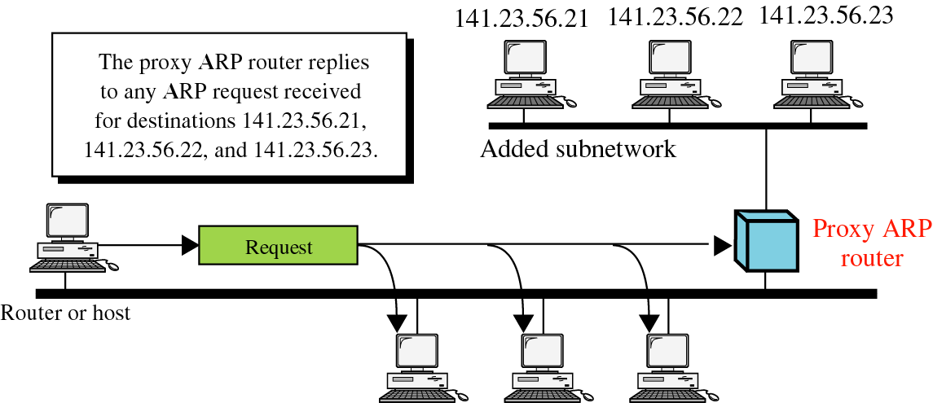
Figure 8-6
Notes:
ARP Request: What is the MAC address of 141.23.56.21?
ARP Reply from router: 141.23.56.21 is at <router's MAC address>

Slide 19
References
Forouzan, “TCP/IP protocol Suite”., Chapter 8. (Background of ARP)

